Slide 1

DATA ANALYSIS
FOR SHORT_TERM RENTAL

Slide 2
01
PROFITABILITY

Slide 3
？
Are short-term rentals more profitable?

Slide 4



Slide 5
75 of 244 Properties are more profitable on short-term rental

Slide 6
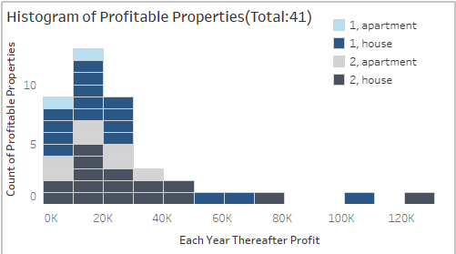
41 of 244 properties could have
more than $6,000 additional profit
each year

Slide 7
02
Sensitivity Analysis

Slide 8
Consideration | Worst Case Scenario | Best Case Scenario
Additional profit needed for a property to be considered “more profitable as a short-term rental” | $10,000 | $5000
Cost to convert property to short-term rental (includes furnishing and decorating) | $40,000 | $20,000
Years to depreciate capital expenditures | 3 | 7
Yearly upkeep | $8,000 | $5,000
Service fees to short-term stay website (e.g. Airbnb) | 25% | 15%
Regulatory fees (taxes and potential legal fees) | 15% | 10%
Hospitality charges (key service, cleaning, re-stocking) | $150 | $70
Typical stay duration (days) | 1 | 4
Monthly utilities | $400 | $200
Additional Annual Profit | $120,000 | $1,613M

Slide 9
Most Sensitive Assumptions
Transaction Fees
Length of Stay

Slide 10
TRANSACTION FEES

Slide 11
AVERAGE LENGTH OF STAY

Slide 12
03
SUGGESTIONS

Slide 13
BUDGET
500K

Slide 14
The initial capital required to convert a long-term rental property to a short-term rental property is $30,000 (for furnishings, linens, etc.)
Under the budget of Watershed, choosing 16 most profitable properties: W46, W66, W67, W107, W108…(See White Paper)
The initial capital investment needed to implement the recommendation would be $480k (16×$30,000)

Slide 15
Profit & Cash Flow

Slide 16
LOCATION
New York, NY
Palo Alto, CA
San Diego, CA
Austin, TX
Miami, FL

Slide 17
04
Conclusion

Slide 18

Do it!

Slide 19

The annual profit will increase almost a million dollars on budget
It will still be profitable even in the worst case

Slide 20
THANK YOU

